Slide 1

Thermal Systems Heat Exchanger Design Presentation
Group 1
Diana Tiburcio, Jakob Werle, Yireh Byas, Selinez Soto

Slide 2
Table of Contents
Calculations
Prototype
Fabrication
Testing
Results

Slide 3
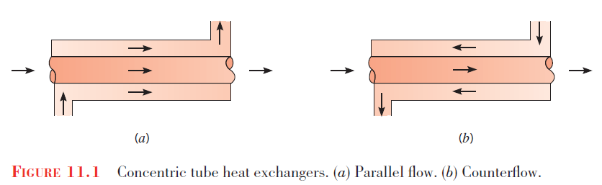
Problem
Design concentric tube heat exchanger
Create largest temperature difference
Analyze how parameters affect design choices
Constraints
Must fit on test bench
Cold flow temp – cold hose water
Hot water temp – small tank w/ water heater < 100°C
Notes:
JW

Slide 4
Prototyping

Slide 5
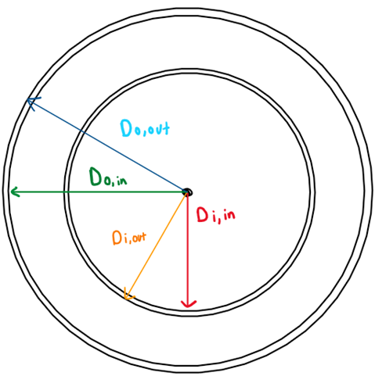
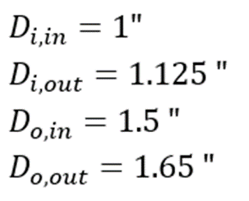
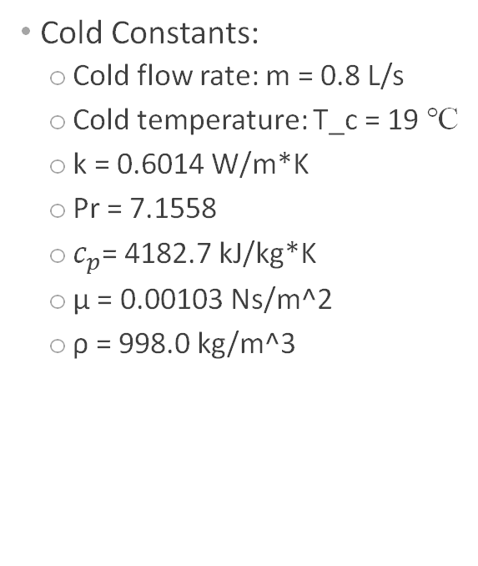
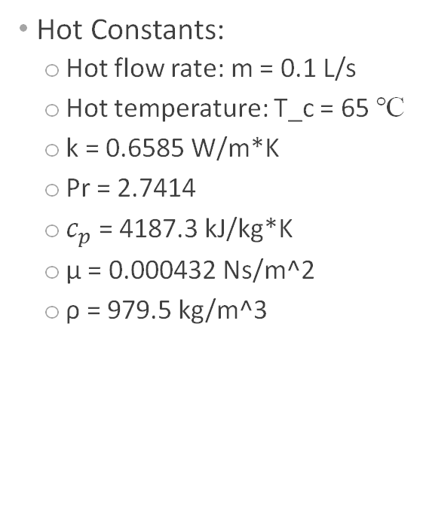
Calculations and Methods
Cold Constants:
Cold flow rate: m = 0.8 L/s
Cold temperature: T_c = 19 ℃
k = 0.6014 W/m*K
Pr = 7.1558
$c_{p}$= 4182.7 kJ/kg*K
μ = 0.00103 Ns/m^2
ρ = 998.0 kg/m^3
Hot Constants:
Hot flow rate: m = 0.1 L/s
Hot temperature: T_c = 65 ℃
k = 0.6585 W/m*K
Pr = 2.7414
$c_{p}$= 4187.3 kJ/kg*K
μ = 0.000432 Ns/m^2
ρ = 979.5 kg/m^3
Schematic 1: Cross sectional view of the heat exchange system
Notes:
YB

Slide 6
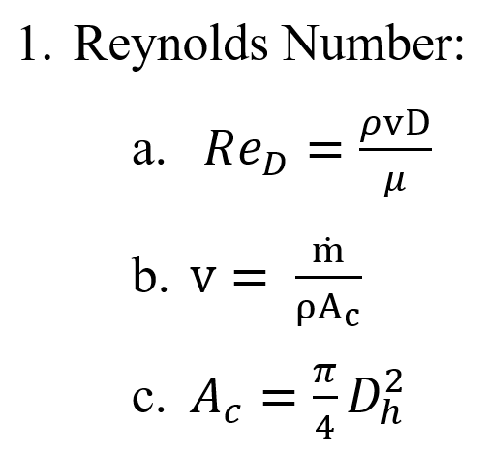
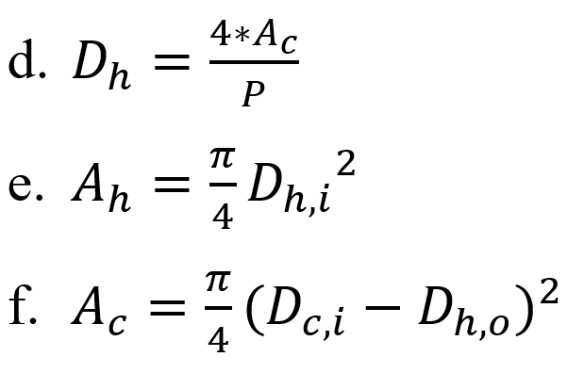
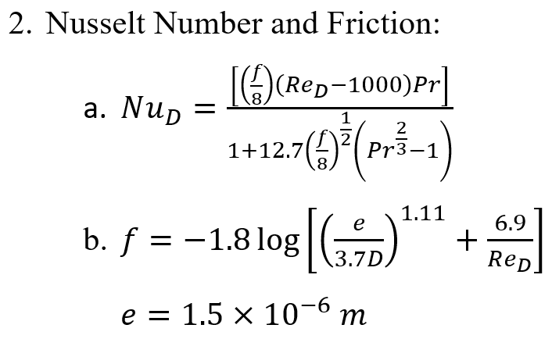
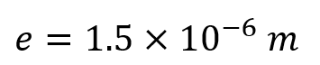
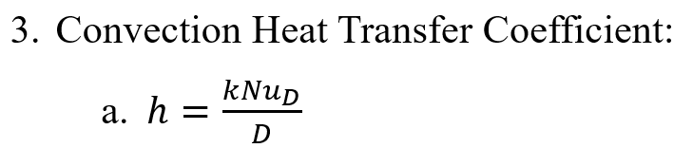
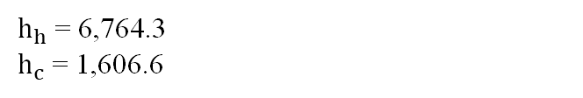
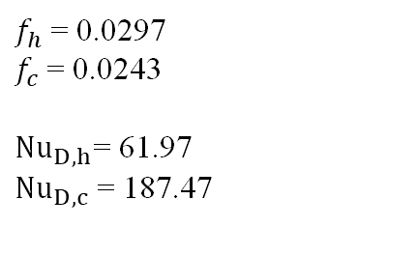
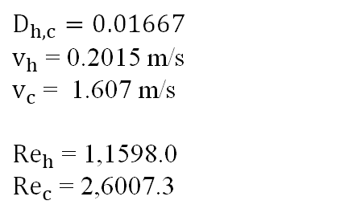
Calculations and Methods
$D_{h,c}=0.01667$
$v_{h}$= 0.2015 m/s
$v_{c}$= 1.607 m/s
${Re}_{h}$= 1,1598.0
${Re}_{c}$= 2,6007.3
$f_{h}$= 0.0297
$f_{c}$= 0.0243
${Nu}_{D,h}$= 61.97
${Nu}_{D,c}$= 187.47
$h_{h}$= 6,764.3
$h_{c}$= 1,606.6
Notes:
DT

Slide 7
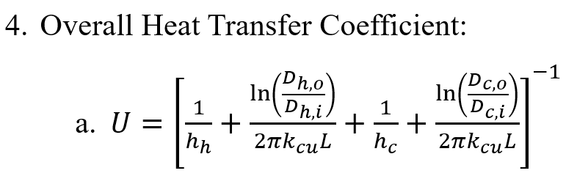
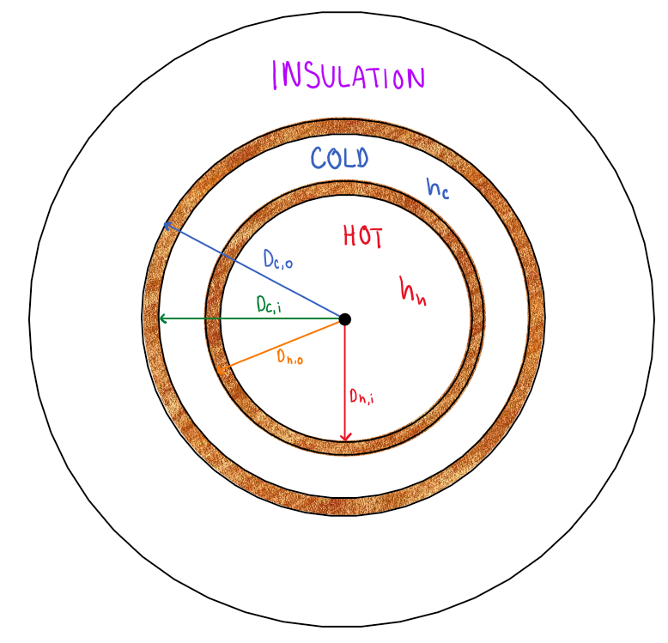
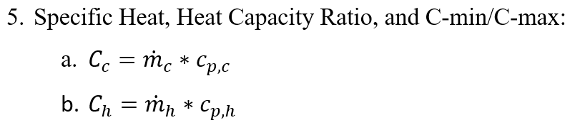
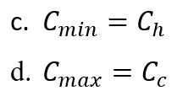
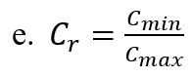
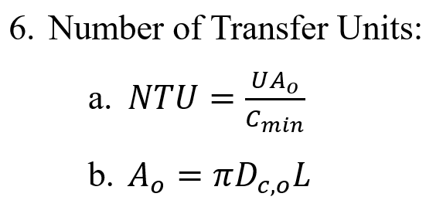
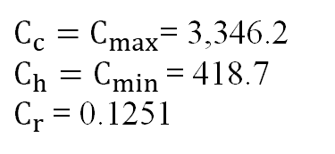
Calculations and Methods
U = 1,177.3
$C_{c}=C_{max}$= 3,346.2
$C_{h}=C_{min}$= 418.7
$C_{r}$= 0.1251
NTU = 0.3646
Schematic 2: Detailed cross section view of the heat exchange system
Notes:
DT

Slide 8
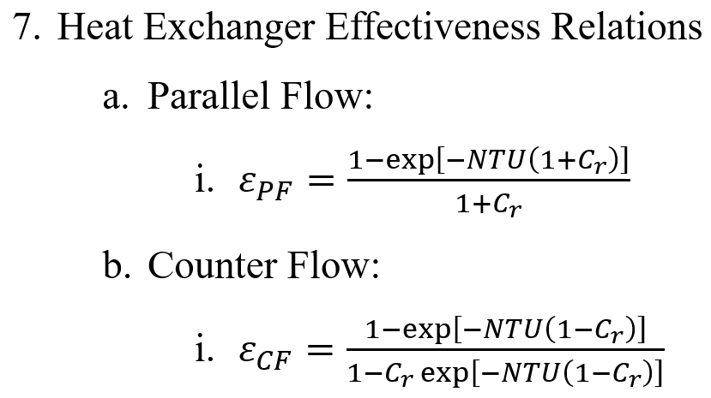
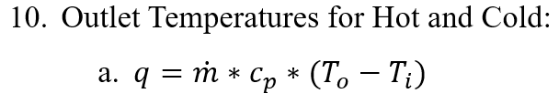
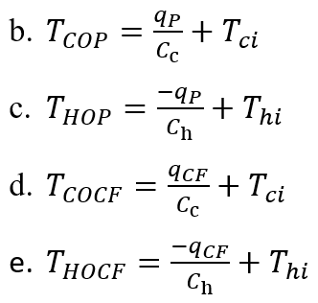
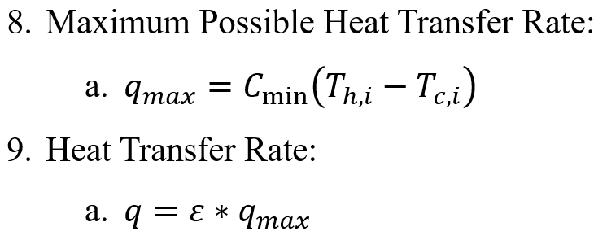
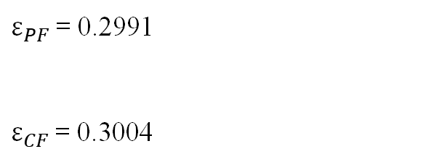
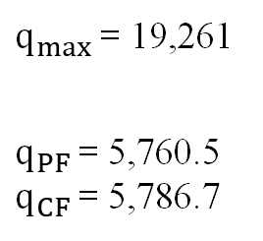
Calculations and Methods
$ε_{PF}$= 0.2991
$ε_{CF}$= 0.3004
$q_{max}$ = 19,261
$q_{PF}$= 5,760.5
$q_{CF}$= 5,786.7
Parallel Flow:
Hot Output Temperature = 51.24 °C
Cold Output Temperature = 20.72 °C
Counter Flow:
Hot Output Temperature = 51.18 °C
Cold Output Temperature = 20.73 °C
Notes:
YB

Slide 9
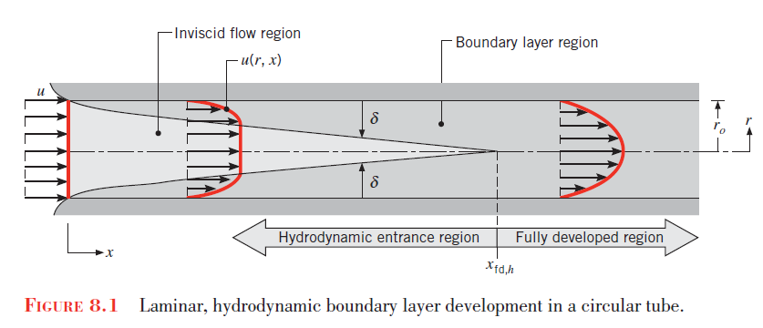
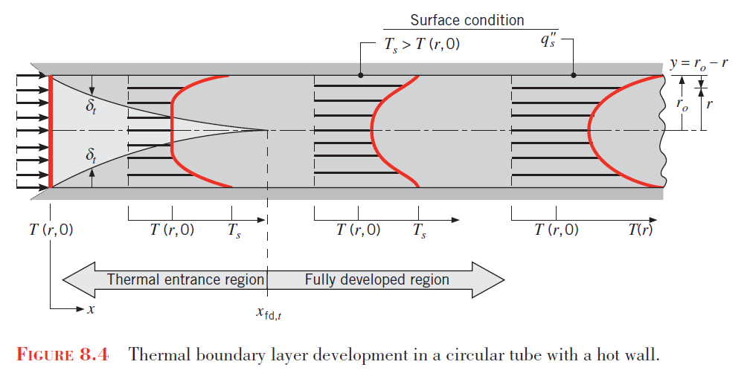
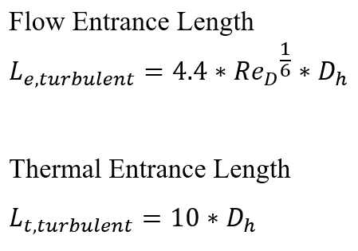
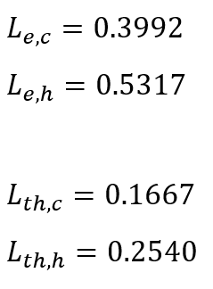
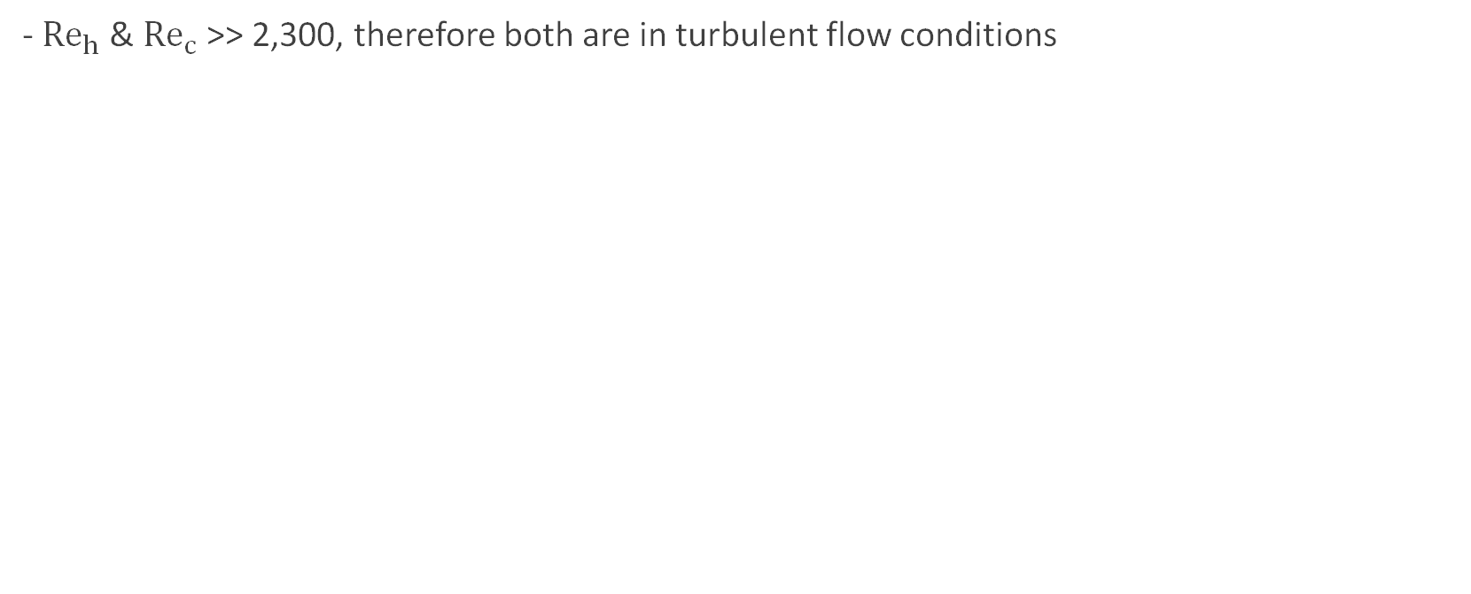
Thermal and Flow Entrance Length
- ${Re}_{h}$& ${Re}_{c}$>> 2,300, therefore both are in turbulent flow conditions
Notes:
DT

Slide 10
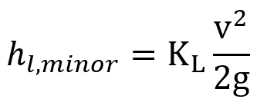
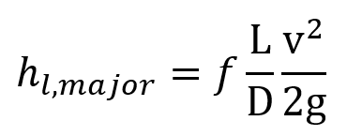
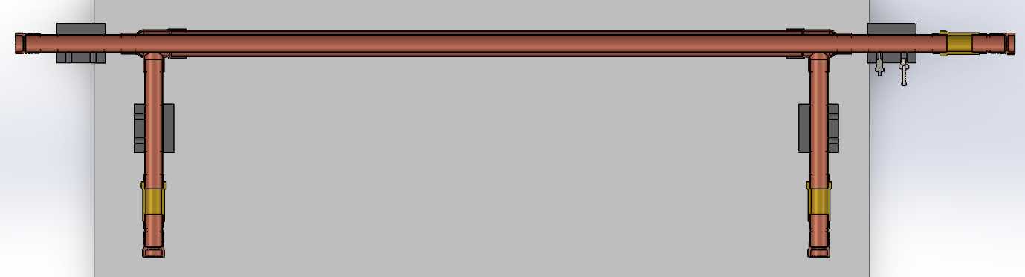
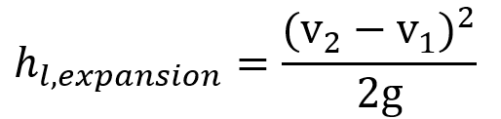
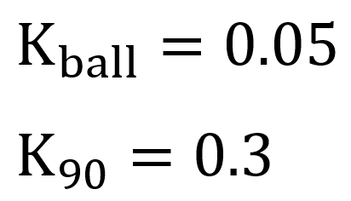
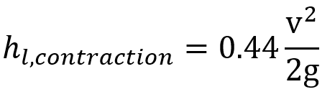
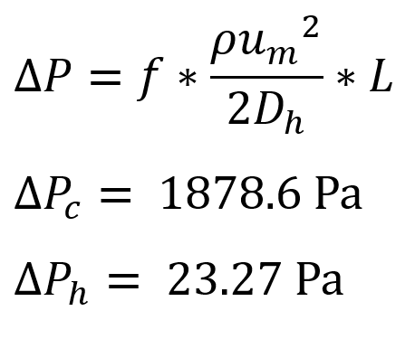
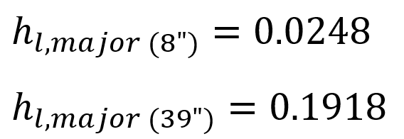
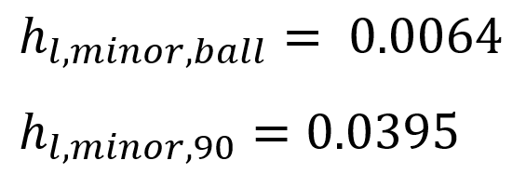
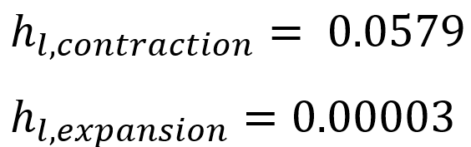
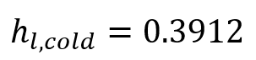
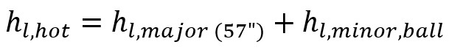
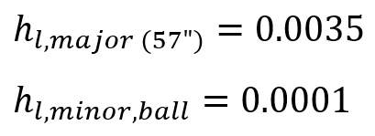
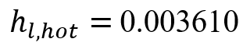
Pressure Difference and Head Loss
90̊ & Contraction
90̊ & Expansion
Hot (57”)
Ball
Cold (39”)
Cold (8”)
Ball
Ball
Schematic 3: Cross sectional view of the final heat exchange system with outlined head loss and water flow
Notes:
DT

Slide 11
Design Optimization
Figure 1: Theoretical hot and cold output temperatures of both counter and parallel flows with varying cold flowrates
Figure 2: Theoretical hot and cold output temperatures of both counter and parallel flows with varying hot flowrates
Figure 3: Theoretical hot and cold output temperatures for the counter flow heat exchanger at different lengths
Notes:
DT

Slide 12
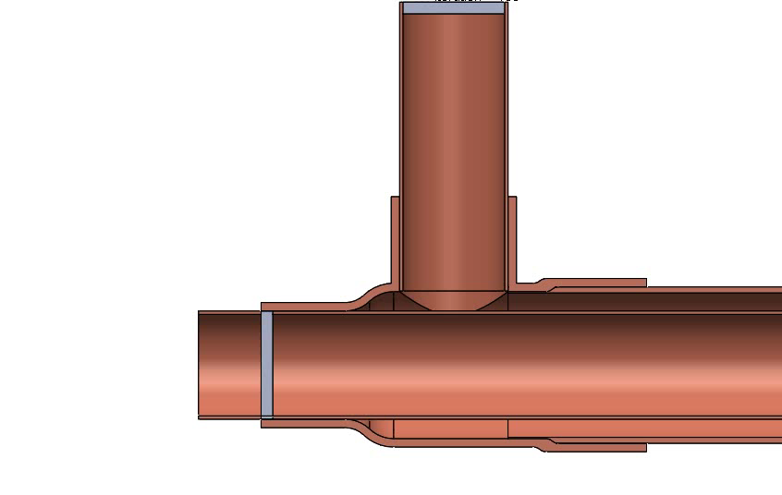
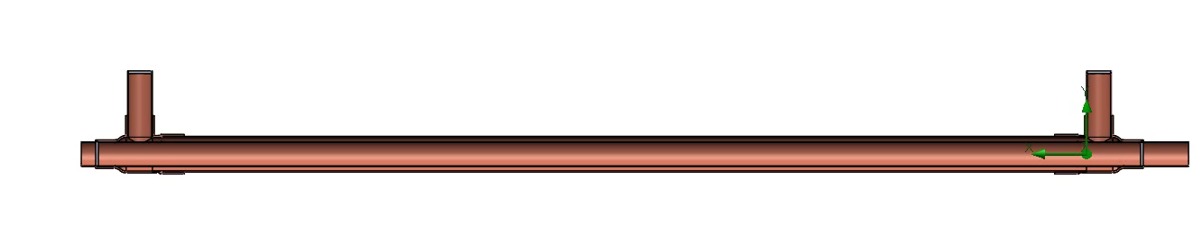
SolidWorks Simulation

Slide 13
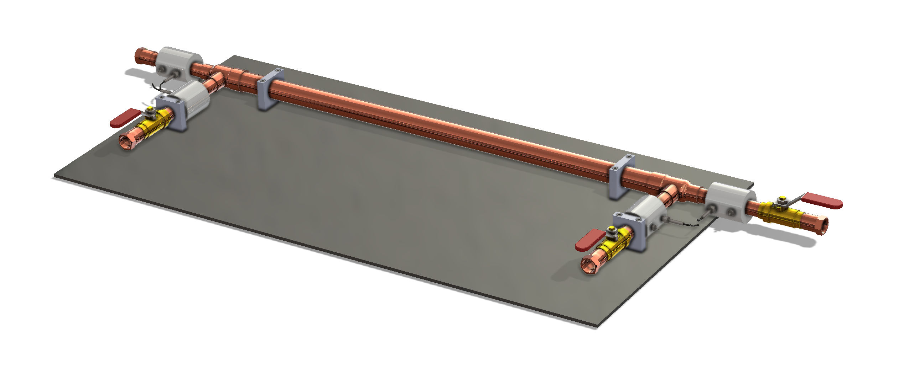
Final Design
Schematic 4: Isometric view of final heat exchanger prototype

Slide 14
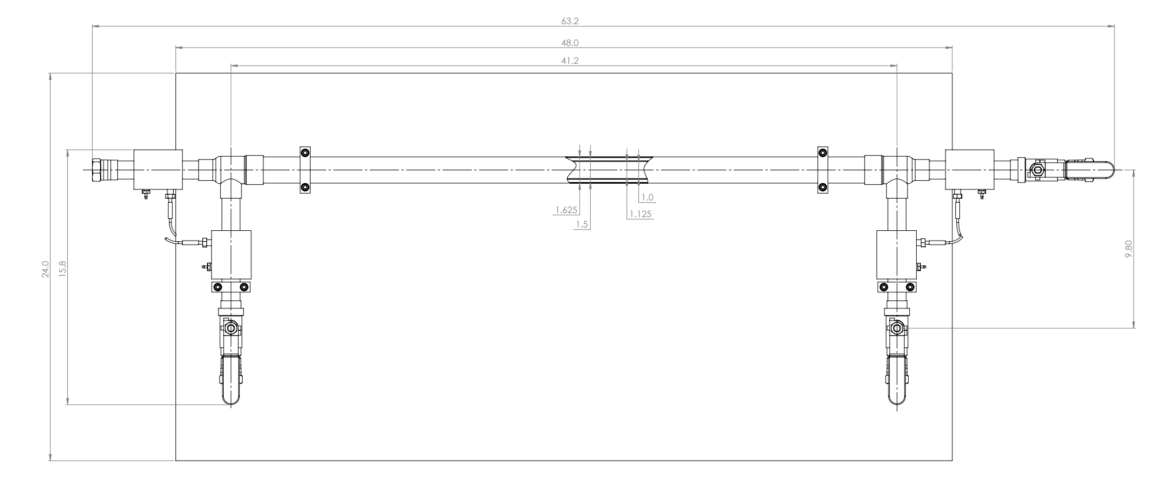
Final Design
Schematic 5: Drawing and dimensions of final heat exchanger prototype

Slide 15
Fabrication
Notes:
JW

Slide 16
Fabrication Process
Model & draw heat exchanger components in SolidWorks
Create bill of materials --> place part orders
Manufacture in house parts
Assemble & solder heat exchanger components
Leakage tests on heat exchanger
Notes:
JW

Slide 17
Bill of Materials
ITEM NO | MFR NO | DESCRIPTION | QTY | COST | NOTES
1 | 5175K136 | Cu Pipe 1.125 OD x 1.055 ID x 57 L | 57 | $0.53 | Provided by COE
2 | 5175K136 | Cu Pipe 1.125 OD x 1.055 ID x 2 L | 2 | $0.53 | Provided by COE
3 | 5175K138 | Cu Pipe 1.625 OD x 1.527 ID x 39 L | 39 | $1.08 | Provided by COE
4 | 5175K138 | Cu Pipe 1.625 OD x 1.527 ID x 8 L | 8 | $1.08 | Provided by COE
5 | - | Backing Board | 1 | - | Provided by COE
6 | - | 3D Print Brackets | 4 | - | 3D Printed in COE
7 | 5520K215 | Solder-Connect Fitting for Copper Tubing (Tee) | 2 | $19.30 | Right-Angle Tee, Female Socket-Connect, 1-1/2 x 1 Tube Size
8 | 5520K411 | Solder-Connect Fitting for Copper Tubing (Adaptor) | 4 | $9.30 | Adapter, Female Socket-Connect, 1 Tube Size x 3/4 NPT Female
9 | 47865K55 | Brass On/Off Valve | 3 | $28.41 | Solder-Connect Female for 1-1/8" Tube OD
10 | 8624K44 | Moisture-Resistant HDPE Rod 2-1/2 OD x 24 L | 1 | $74.50 | Makes 8 pieces
11 | 5350K31 | Zinc-Plated Steel Barbed Hose Fitting | 4 | $4.86 | For Air and Water, Adapter for 1/4" Hose ID, 1/8 NPT Male
 |  |  | TOTAL | $336.93
 |  |  | ACT | $227.71
Figure 4: Chart of All Components of the Heat Exchanger System with Corresponding Costs
Notes:
JW

Slide 18
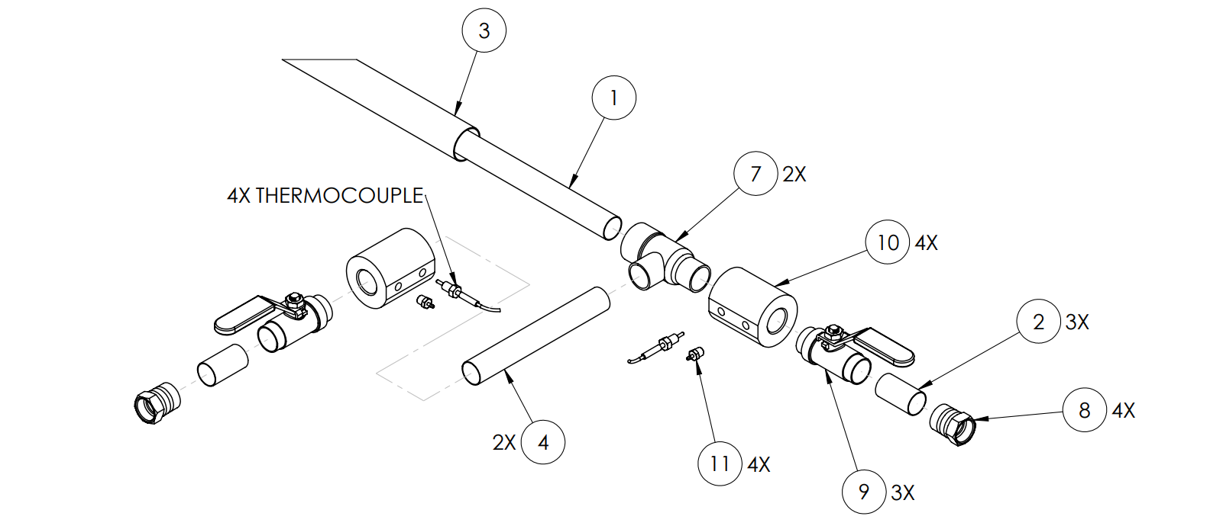
Overall Assembly
Schematic 6: Blown up view of part assembly for final heat exchanger prototype
Notes:
JW

Slide 19



Sensor Mounting
Material: High Density Polyurethane ~0.4 W/m*K
HDPE chosen to isolate thermocouples from adjacent heat transfer
Sized so probe sits in stream, not to interrupt flow
Press fit onto copper tubing
Leak tested separately
Image1: 3D Schematic and actual view of sensor mounting
Notes:
JW

Slide 20



Tubing Prep and Assembly
Tubing cut with pipe cutter
Dry fitment
Prepare connections
Scuff tubing
Flux
Solder 1st set connections
Press sensor collars
Solder 2nd set connections
Image 2: Solder and Press sensor Assembly
Notes:
JW

Slide 21
Fabrication Re-considerations
NPT threading wears out in HDPE – different material or mounting style
Low tolerance copper tubing not adequate for press fit
Longer barbs for pressure lines
Ball valve leakage – likely from over heating of seal during soldering
Design thermocouple connector manifold – take readings more efficiently
Notes:
JW

Slide 22
Testing

Slide 23

Testing Apparatus
Image 3: Complete view of testing apparatus and set up in parallel flow
Notes:
Selinez

Slide 24
Testing Procedure
Allow hot water tank to heat to ~65°C (3+ hrs)
Install thermocouples and attach pressure lines
Attach water lines to heat exchanger – configure parallel or counter flow
Open cold water spicket and turn on hot water pump
Adjust flow rates to trial specification
Allow temperatures to stabilize then read 3x per trial:
Inlet hot & cold temperatures
Outlet hot & cold temperatures
Pressure differential hot & cold
Allow hot water tank to reheat in between trials (~15min)
Notes:
Selinez

Slide 25

Testing Example
Video 1: Running experimental trials for counterflow flow rates

Slide 26


Testing Complications
Thermocouple failure and calibration errors
Rebuild attempted
Offset values
Cavitation in hot flow
Pressure reading inaccuracies
Small leaks from NPT threads
Plastic tubing failure
Image 4: Rebuilt thermal couple and attached pressure tube
Notes:
JW

Slide 27
Results

Slide 28
Parallel Flow Experimental Results
 |  |  | Hot Side Flow Rate (L/min) | Cold Side Flow Rate (L/min) | Cold Inlet Temp | Cold Outlet Temp | Bath Temp | Hot Inlet Temp | Hot Outlet Temp
Target Cold Flow Rate (L/min) | 0.8 | Experimental Trial 1 | 6.45 | 48.2 | 12.2 | 13.2 | 65 | 47.1 | 36.6
Target Hot Flow Rate (L/min) | 0.1 | Experimental Trial 2 | 6.5 | 47.9 | 12.1 | 13.2 | 67 | 41.5 | 36.7
 |  | Experimental Trial 3 | 6.5 | 48.1 | 10.9 | 12.4 | 66 | 60.3 | 37.45
 |  | Average | 6.48 | 48.07 | 11.73 | 12.93 | 66.00 | 49.63 | 36.92
 |  | Temperature Change |  |  | 1.20 |  |  | 12.72
Target Cold Flow Rate (L/min) | 0.8 | Experimental Trial 1 | 12.1 | 48 | 12.2 | 14.3 | 65.6 | 59.6 | 43.3
Target Hot Flow Rate (L/min) | 0.2 | Experimental Trial 2 | 12.4 | 48.2 | 11.5 | 13.45 | 66 | 59.5 | 38.6
 |  | Experimental Trial 3 | 12.6 | 48.1 | 12.4 | 14.4 | 66 | 60.5 | 38.8
 |  | Average | 12.37 | 48.10 | 12.03 | 14.05 | 65.87 | 59.87 | 40.23
 |  | Temperature Change |  |  | 2.02 |  |  | 19.63
Target Cold Flow Rate (L/min) | 0.8 | Experimental Trial 1 | 48.4 | 48.3 | 12.2 | 18.9 | 67.3 | 58.1 | 52.1
Target Hot Flow Rate (L/min) | 0.8 | Experimental Trial 2 | 48.4 | 48.1 | 11 | 19.3 | 65 | 62.5 | 55.2
 |  | Experimental Trial 3 | 48 | 48.1 | 11.7 | 18 | 66.3 | 63.1 | 56.5
 |  | Average | 48.27 | 48.17 | 11.63 | 18.73 | 66.20 | 61.23 | 54.60
 |  | Temperature Change |  |  | 7.10 |  |  | 6.63
Figure 5: Experimental results of the parallel flow heat exchanger tests at different flow rates
Notes:
DT

Slide 29
Counter Flow Experimental Results
 |  |  | Hot Side Flow Rate (L/min) | Cold Side Flow Rate (L/min) | Cold Inlet Temp | Cold Outlet Temp | Bath Temp | Hot Inlet Temp | Hot Outlet Temp
Target Cold Flow Rate (L/min) | 0.8 | Experimental Trial 1 | 6 | 48.6 | 10.1 | 11.7 | 66.3 | 64.3 | 48
Target Hot Flow Rate (L/min) | 0.1 | Experimental Trial 2 | 5.9 | 48.2 | 9.9 | 11.6 | 66 | 65.05 | 48.45
 |  | Experimental Trial 3 | 6 | 48.7 | 10.1 | 11.6 | 66.4 | 65.4 | 48.2
 |  | Average | 5.97 | 48.50 | 10.03 | 11.63 | 66.23 | 64.92 | 48.22
 |  | Temperature Change |  |  | 1.60 |  |  | 16.70
Target Cold Flow Rate (L/min) | 0.8 | Experimental Trial 1 | 12.4 | 48.2 | 10.55 | 12.45 | 66.75 | 62.4 | 56.3
Target Hot Flow Rate (L/min) | 0.2 | Experimental Trial 2 | 12.4 | 48.2 | 10.1 | 12.3 | 66 | 64.9 | 55.5
 |  | Experimental Trial 3 | 12.4 | 48.2 | 9.9 | 12.2 | 66 | 64.8 | 55.8
 |  | Average | 12.40 | 48.20 | 10.18 | 12.32 | 66.25 | 64.03 | 55.87
 |  | Temperature Change |  |  | 2.13 |  |  | 8.17
Target Cold Flow Rate (L/min) | 0.5 | Experimental Trial 1 | 6.3 | 30.25 | 10 | 12.3 | 66 | 65 | 49.6
Target Hot Flow Rate (L/min) | 0.1 | Experimental Trial 2 | 6.3 | 30.1 | 10.2 | 12.5 | 66.75 | 65.55 | 50
 |  | Experimental Trial 3 | 6.3 | 30.1 | 10.1 | 12.9 | 66.7 | 65.2 | 49.8
 |  | Average | 6.30 | 30.15 | 10.1 | 12.57 | 66.48 | 65.25 | 49.8
 |  | Temperature Change |  |  | 2.47 |  |  | 15.45
Figure 6: Experimental results of the counter flow heat exchanger tests at different flow rates
Notes:
YB

Slide 30
Summary of Data – Parallel Flow
 |  |  | Theoretical |  | Solidworks |  | Experimental |  | Theoretical |  | Solidworks
Hot Flow Rate (L/min) | Cold Flow Rate (L/min) | Heat Transfer Rate | Hot Outlet Temp | Cold Outlet Temp | Hot Outlet Temp | Cold Outlet Temp | Hot Outlet Temp | Cold Outlet Temp | Hot Outlet Temp | Cold Outlet Temp | Hot Outlet Temp | Cold Outlet Temp
0.10 | 0.80 | 5838.35 | 50.17 | 13.86 | 53.78 | 11.66 | 36.92 | 12.93 | 26% | 7% | 31% | 11%
0.20 | 0.80 | 9059.55 | 53.60 | 15.19 | 46.42 | 12.58 | 40.23 | 14.05 | 25% | 7% | 13% | 12%
0.80 | 0.80 | 16393.81 | 56.32 | 16.54 | 56.6176 | 15.4717 | 54.60 | 18.73 | 3% | 13% | 4% | 21%
Figure 7: Comparison of the theoretical and SolidWorks results to the experimental results with corresponding percent errors.
Notes:
DT SS

Slide 31
Summary of Data - Counter Flow
 |  |  | Theoretical |  | Solidworks |  | Experimental |  | Theoretical |  | Solidworks
Hot Flow Rate (L/min) | Cold Flow Rate (L/min) | Heat Transfer Rate | Hot Outlet Temp | Cold Outlet Temp | Hot Outlet Temp | Cold Outlet Temp | Hot Outlet Temp | Cold Outlet Temp | Hot Outlet Temp | Cold Outlet Temp | Hot Outlet Temp | Cold Outlet Temp
0.10 | 0.80 | 5838.35 | 48.55 | 12.04 | 45.08 | 11.69 | 48.22 | 11.63 | 1% | 3% | 7% | 1%
0.20 | 0.80 | 9059.55 | 51.94 | 13.29 | 55.31 | 12.75 | 55.87 | 12.32 | 8% | 7% | 1% | 3%
0.10 | 0.50 | 5390.27 | 50.62 | 13.15 | 49.36 | 13.42 | 49.80 | 12.57 | 2% | 4% | 1% | 6%
Figure 8: Comparison of the theoretical and SolidWorks results to the experimental results with corresponding percent errors.
Notes:
SS

Slide 32


Summary of Data
Figure 9: Visual comparison of the theoretical and SolidWorks results to the experimental results.
Notes:
Selinez

Slide 33
Project Improvements
Outline project goals and constraints
Experiment run through before theory review – understand data collection
More organized testing schedule for teams
Better management of sensitive sensors – per team?
More focus on teamwork
Notes:
YB

Slide 34

Questions?

